Slide 1
Science Communication & Pitching
By Dr. Patamasuda Intuprapa

Slide 2
What is Science Communication
Science communication is the public communication of science-related topics to non-experts.
Science communication also includes communication between scientists (for instance through scientific journals), as well as between scientists and non-scientists.

Slide 3
Purpose of Science Communication
to increase scientific awareness
to simplify science and connect it to the lives of people
to raise science culture and literacy which in turn allows for development and enhanced citizenry
to promote further research so that our works are credited in a good manner.
to inform decision making, including political and ethical thinking
to raise funding

Slide 4

Perspectives on funding science : Science communication must be included !
to inform decision making, including
political and ethical thinking
to raise funding

Slide 5

What is “Pitching ” ?
a speech or act that attempts to persuade someone to buy or do something.
(Cambridge Dictionary)

Slide 6

How to create content for pitching?
Begin with a problem
How does the product work to help solving the problem?
Who is the target of the product?
What is your market-entry strategy?
KILLER SLIDE!• Give a reason for the audiences to believe that you are ready to… ROCK!
Or……

Slide 7
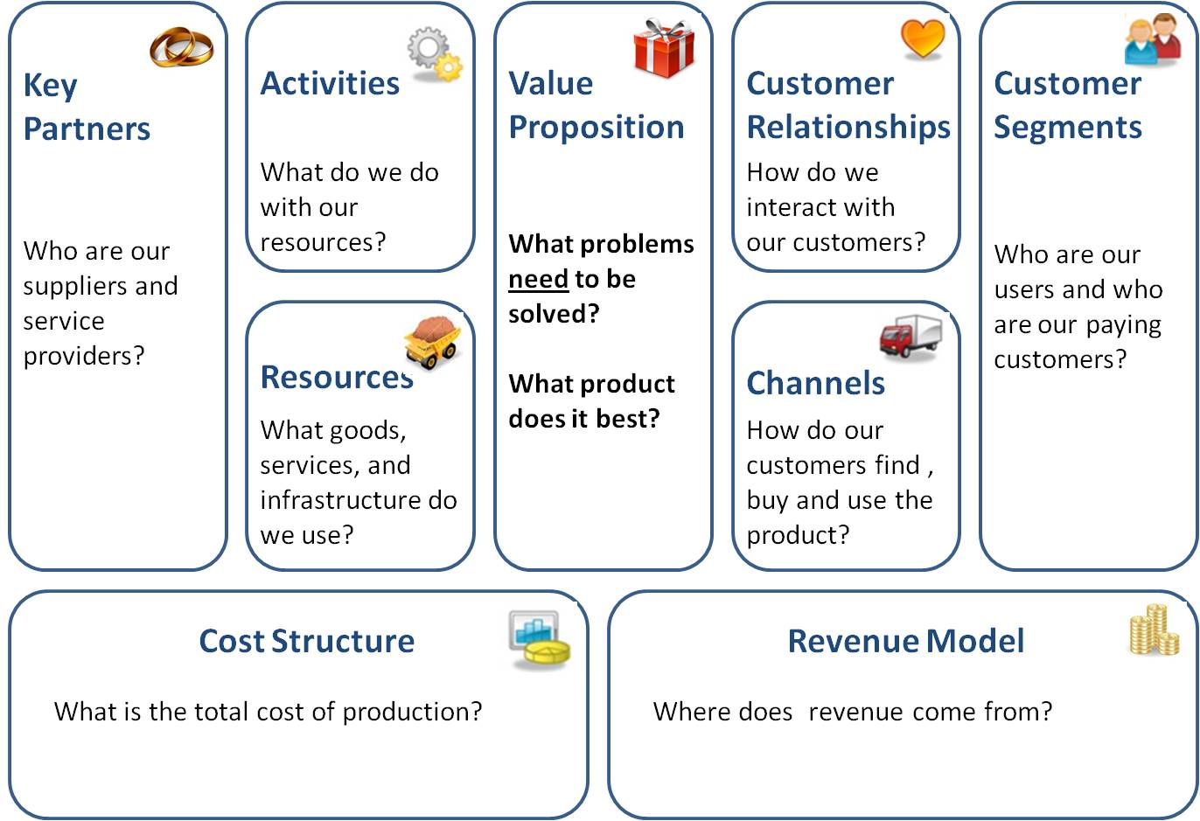
Using business model canvas

Slide 8
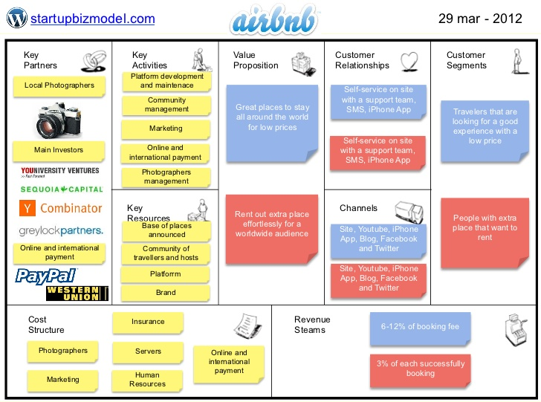
airbnb

Slide 9
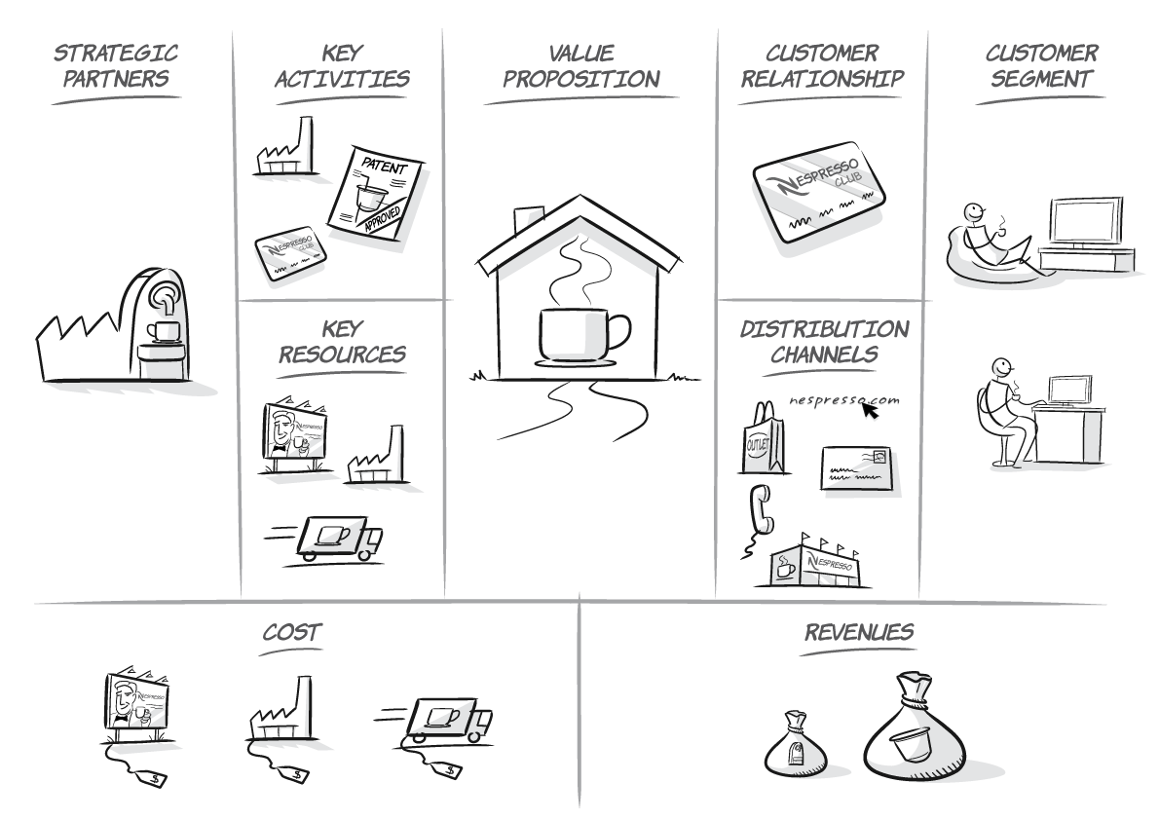
Nespresso

Slide 10
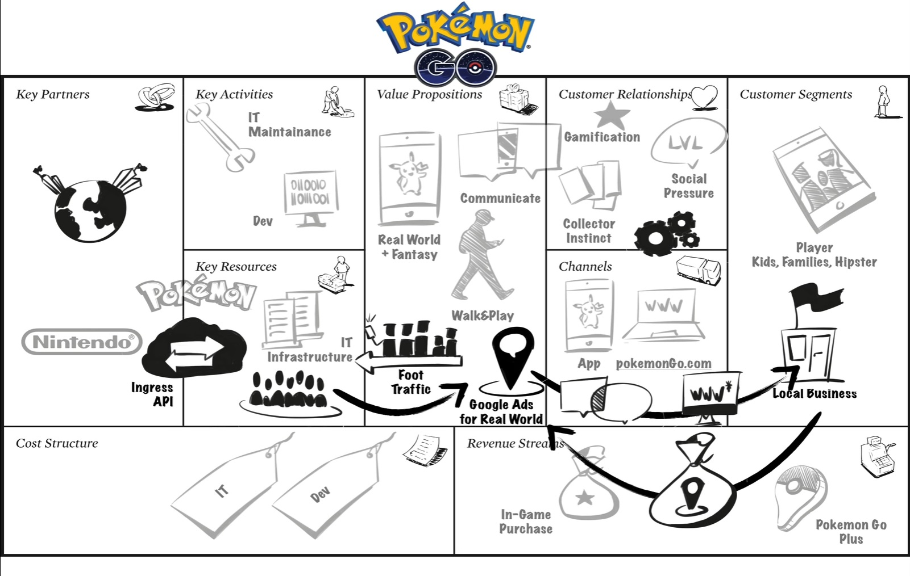
Pokemon Go

Slide 11
How to deliver a good pitch ?
Tell a story to create a connection
Back it up with facts
Be wildly enthusiastic
Anticipate questions, and answer them ahead of time
Show them the exit

Slide 12

Presenting
Dress to kill
Smile and Make Eye Contact with your Audience
Use your Voice Effectively
Use your Body Too
Relax, Breathe and Enjoy

Slide 13
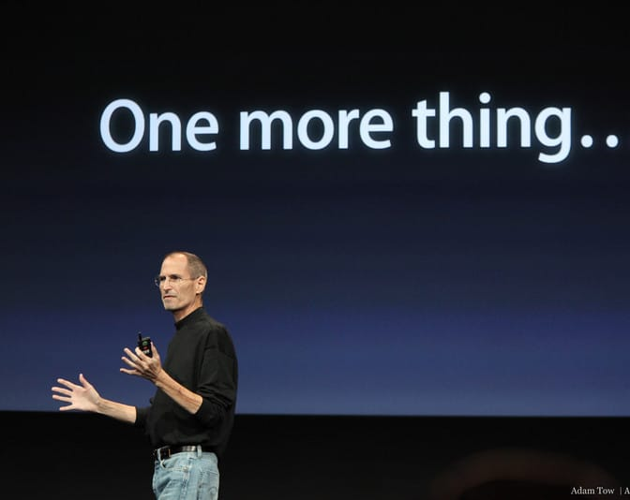
Thank you
Practice makes perfect !

